Slide 1
Object Oriented Programming Concepts Using C++ & Data Structures

Slide 2
Algorithms

Slide 3
Topics Covered
Selection Sort
Insertion Sort
Bubble Sort
Merge Sort

Slide 4
Sorting
Sorting refers to arranging data in a particular format. Sorting algorithm specifies the way to arrange data in a particular order. Most common orders are in numerical or lexicographical order.
Adaptive and Non-Adaptive Sorting Algorithm
A sorting algorithm is said to be adaptive, if it takes advantage of already 'sorted' elements in the list that is to be sorted. That is, while sorting if the source list has some element already sorted, adaptive algorithms will take this into account and will try not to re-order them.
A non-adaptive algorithm is one which does not take into account the elements which are already sorted. They try to force every single element to be re-ordered to confirm their sortedness

Slide 5
Bubble Sort
Comparison-based algorithm in which each pair of adjacent elements is compared
Elements are swapped if they are not in order.
This algorithm is not suitable for large data sets as its average and worst case complexity are of Ο(n²) where n is the number of items.
If we have total n elements, then we need to repeat this process for n-1 times.
It is known as bubble sort, because with every complete iteration the largest element in the given array, bubbles up towards the last place or the highest index, just like a water bubble rises up to the water surface.

Slide 6
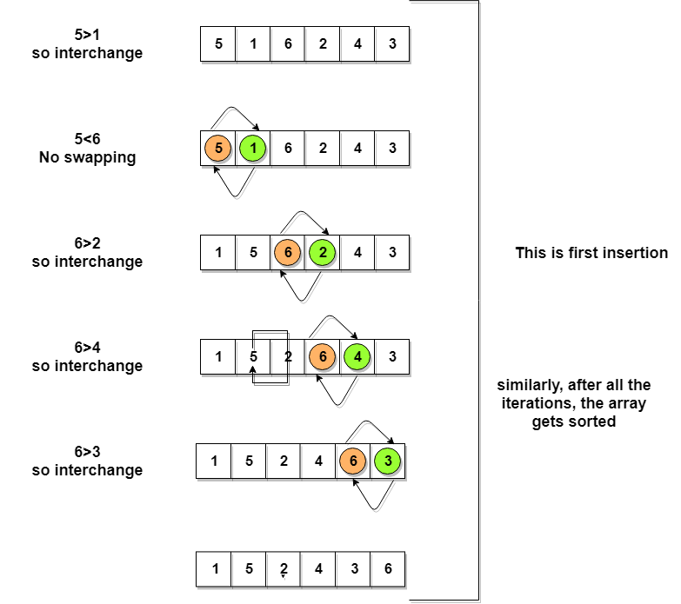
Bubble Sort

Slide 7
Complexity Analysis of Bubble Sort
n-1 comparisons will be done in the 1st pass, n-2 in 2nd pass, n-3 in 3rd pass and so on. So the total number of comparisons will be,
(n-1) + (n-2) + (n-3) + ..... + 3 + 2 + 1
Sum = n(n-1)/2
i.e O(n²)
Worst Case [ Big-O ]: O(n2)
Best Case [Big-omega]: O(n)
Average Case [Big-theta]: O(n2)
best case time complexity will be O(n), it is when the list is already sorted.

Slide 8
Selection Sort
in-place comparison-based algorithm in which the list is divided into two parts, the sorted part at the left end and the unsorted part at the right end.
Initially, the sorted part is empty and the unsorted part is the entire list.
The smallest element is selected from the unsorted array and swapped with the leftmost element, and that element becomes a part of the sorted array. This process continues moving unsorted array boundary by one element to the right.
This algorithm is not suitable for large data sets as its average and worst case complexities are of Ο(n2), where n is the number of items.

Slide 9
Selection Sort
This algorithm will first find the smallest element in the array and swap it with the element in the first position, then it will find the second smallest element and swap it with the element in the second position, and it will keep on doing this until the entire array is sorted.
It is called selection sort because it repeatedly selects the next-smallest element and swaps it into the right place.

Slide 10
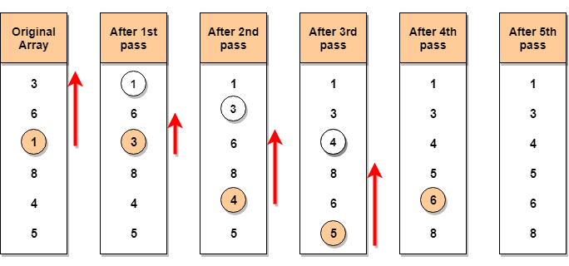
Selection Sort

Slide 11
Complexity Analysis of Selection Sort
Selection Sort requires two nested for loops to complete itself, one for loop is in the function selectionSort, and inside the first loop we are making a call to another function indexOfMinimum, which has the second(inner) for loop.
Hence for a given input size of n, following will be the time and space complexity for selection sort algorithm:
Worst Case [ Big-O ]: O(n²)
Best Case [Big-omega]: O(n²)
Average [Big-theta]: O(n²)

Slide 12
Insertion Sort
In-place comparison-based sorting algorithm. Here, a sub-list is maintained which is always sorted. For example, the lower part of an array is maintained to be sorted.
An element which is to be 'insert'ed in this sorted sub-list, has to find its appropriate place and then it has to be inserted there. Hence the name, insertion sort.
The array is searched sequentially and unsorted items are moved and inserted into the sorted sub-list (in the same array).
This algorithm is not suitable for large data sets as its average and worst case complexity are of Ο(n²), where n is the number of items.

Slide 13
Insertion Sort
In-place comparison-based sorting algorithm. Here, a sub-list is maintained which is always sorted. For example, the lower part of an array is maintained to be sorted.
An element which is to be 'insert'ed in this sorted sub-list, has to find its appropriate place and then it has to be inserted there. Hence the name, insertion sort.
The array is searched sequentially and unsorted items are moved and inserted into the sorted sub-list (in the same array).
This algorithm is not suitable for large data sets as its average and worst case complexity are of Ο(n²), where n is the number of items.

Slide 14
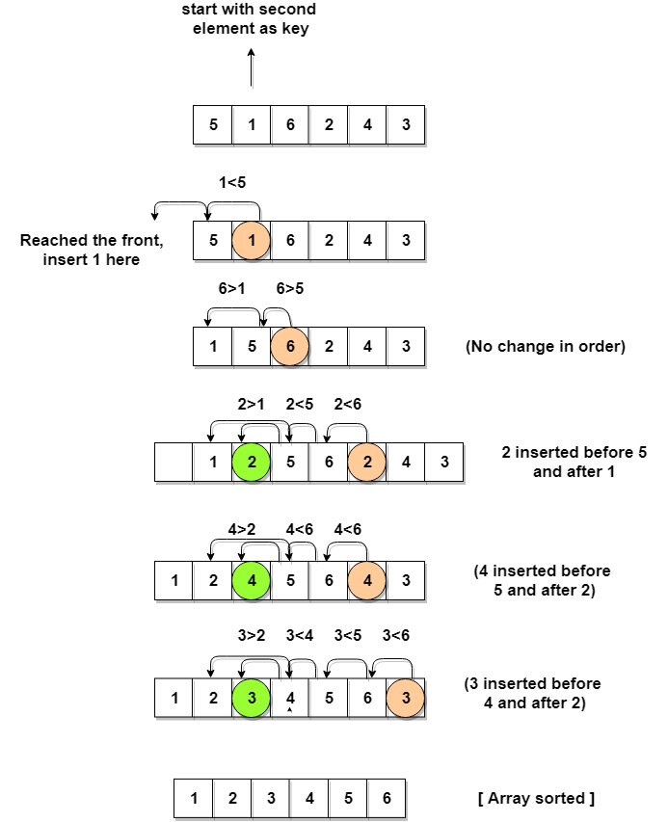
Insertion Sort

Slide 15
Insertion Sort

Slide 16
Complexity Analysis of Insertion Sort
Even though insertion sort is efficient, still, if we provide an already sorted array to the insertion sort algorithm, it will still execute the outer for loop, thereby requiring n steps to sort an already sorted array of n elements, which makes its best case time complexity a linear function of n.
Worst Case Time Complexity [ Big-O ]: O(n²)
Best Case Time Complexity [Big-omega]: O(n)
Average Time Complexity [Big-theta]: O(n²)

Slide 17
Merge Sort
follows the rule of Divide and Conquer to sort a given set of numbers/elements, recursively, hence consuming less time.
Merge sort runs in O(n*log n) time in all the cases.

Slide 18
Divide and Conquer
Single big problem into smaller sub-problems, solve the smaller sub-problems and combine their solutions to find the solution for the original big problem, it becomes easier to solve the whole problem.
The concept of Divide and Conquer involves three steps:
Divide the problem into multiple small problems.
Conquer the subproblems by solving them. The idea is to break down the problem into atomic subproblems, where they are actually solved.
Combine the solutions of the subproblems to find the solution of the actual problem.

Slide 19
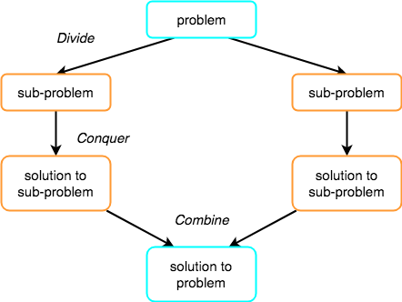
Divide and Conquer

Slide 20
Merge Sort
In merge sort we follow the following steps:
We take a variable p and store the starting index of our array in this. And we take another variable r and store the last index of array in it.
Then we find the middle of the array using the formula (p + r)/2 and mark the middle index as q, and break the array into two subarrays, from p to q and from q + 1 to r index.
Then we divide these 2 subarrays again, just like we divided our main array and this continues.
Once we have divided the main array into subarrays with single elements, then we start merging the subarrays.

Slide 21
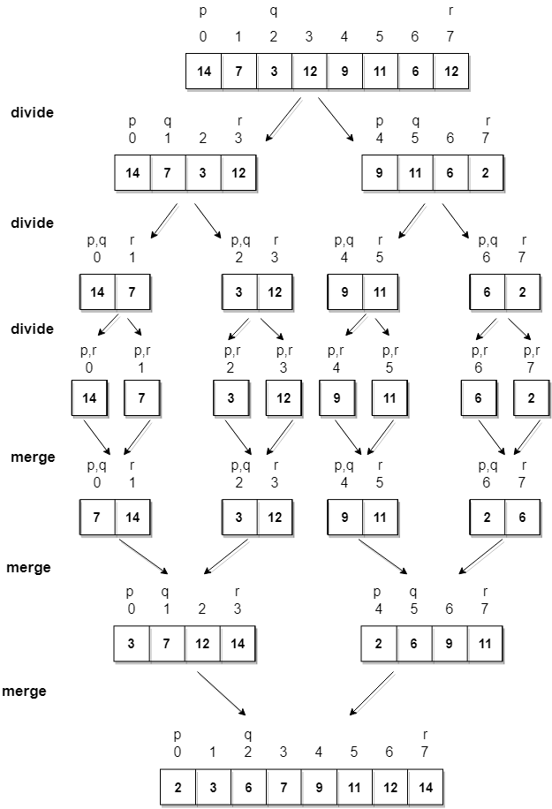
Merge Sort

Slide 22
Complexity Analysis of Merge Sort
As we have already learned in Binary Search that whenever we divide a number into half in every stpe, it can be represented using a logarithmic function, which is log n and the number of steps can be represented by log n + 1(at most)
Also, we perform a single step operation to find out the middle of any subarray, i.e. O(1).
And to merge the subarrays, made by dividing the original array of n elements, a running time of O(n) will be required.
Hence the total time for mergeSort function will become n(log n + 1), which gives us a time complexity of O(n*log n).

Slide 23
Complexity Analysis of Merge Sort
Worst Case Time Complexity [ Big-O ]: O(n*log n)
Best Case Time Complexity [Big-omega]: O(n*log n)
Average Time Complexity [Big-theta]: O(n*log n)
Time complexity of Merge Sort is O(n*Log n) in all the 3 cases (worst, average and best) as merge sort always divides the array in two halves and takes linear time to merge two halves.
It requires equal amount of additional space as the unsorted array. Hence its not at all recommended for searching large unsorted arrays.
It is the best Sorting technique used for sorting Linked Lists.

